Slide 1
Coursera Capstone project
Coursera IBM Data Science Certification
Dinh-Dung Le
2020.03.08

Slide 2
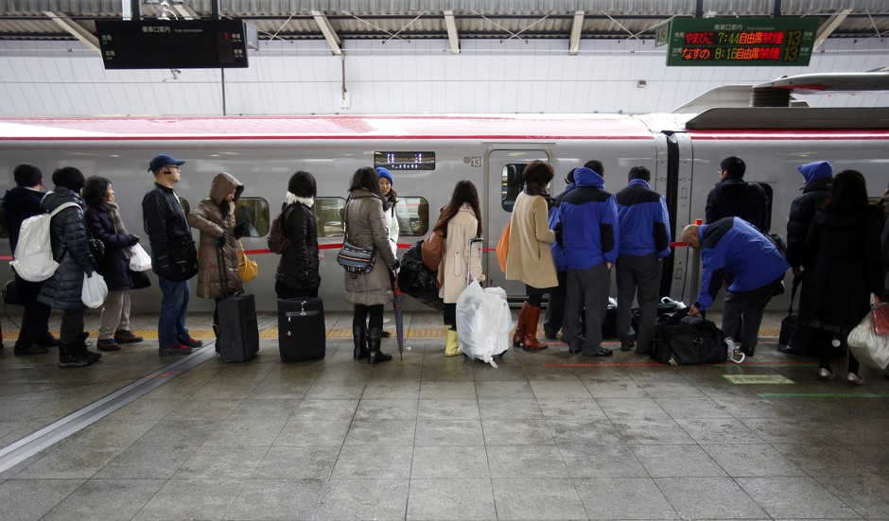
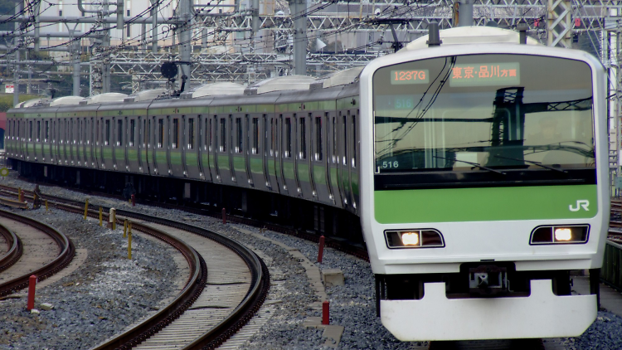
1. Introduction/Business Problem
1.1 Introduction
I used to live in Japan 3 years and really impressed by the convenience of the railway system.
It is the scenes that plays out each weekday morning across Tokyo. Suit-clad office workers, gaggles of schoolchildren, and other travelers gamely wend their way through the city’s sprawling rail stations.

Slide 3
1. Introduction/Business Problem
1.2 Problem to be resolved:
Tokyo is home to the world’s busiest train stations, with the capital’s rail operators handling a combined 13 billion passenger trips annually.
In this project, I will try to use Data Science techniques to investigate about the prospects of restaurant at station in Tokyo, Japan.
1.3 Interested Audience
I believe the methodology, tools and strategy used in this project is relevant for a person or entity considering moving to Tokyo and want to find their country’s food.
Likewise, it can be helpful approach to explore the opening of a new business. The use of FourSquare data and mapping techniques combined with data analysis will help resolve the key questions arisen.
Lastly, this project is a good practical case for a person developing Data Science skills.

Slide 4
2. Data using in this project
2.1 Data Requirements:
Geodata for railway stations in central Tokyo with venues established using Foursquare.
List of metro train stations is at: https://en.wikipedia.org/wiki/List_of_Tokyo_Metro_stations
2.2 Data Sources, Data Processing and Tools used
Tokyo data and map is to be created with use of Nominatim , Foursquare and Folium mapping.
List of railway stations and Wards in Tokyo is collected using BeautifulSoup.

Slide 5
3. Methodology
Web scraping Wikipedia page for stations list .
Get latitude and longitude coordinates using Geocoder.
Use Foursquare API to get venue data.
Perform clustering on the data by using k-means clustering.
Visualize the clusters in a map using Folium.

Slide 6

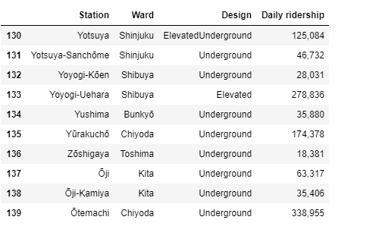
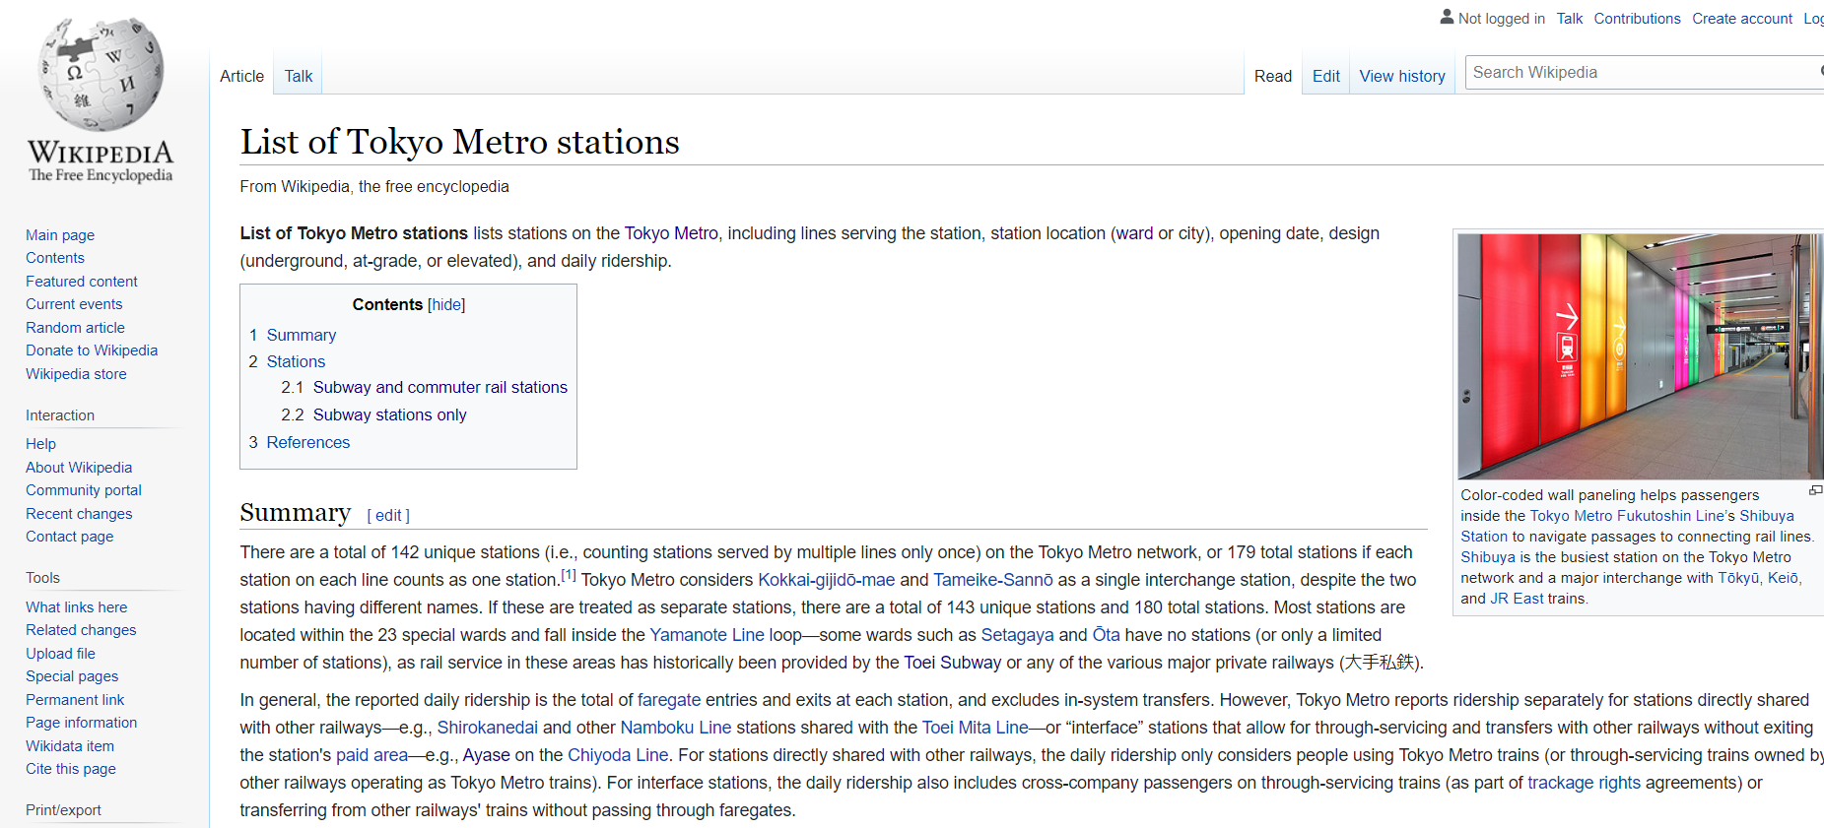
4. Implementation
Web scraping Wikipedia page for stations list: collect information about the railway station in central Tokyo using the BeautifulSoup
https://en.wikipedia.org/wiki/List_of_Tokyo_Metro_stations

Slide 7
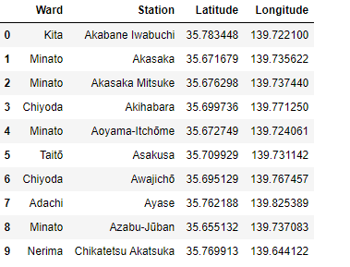
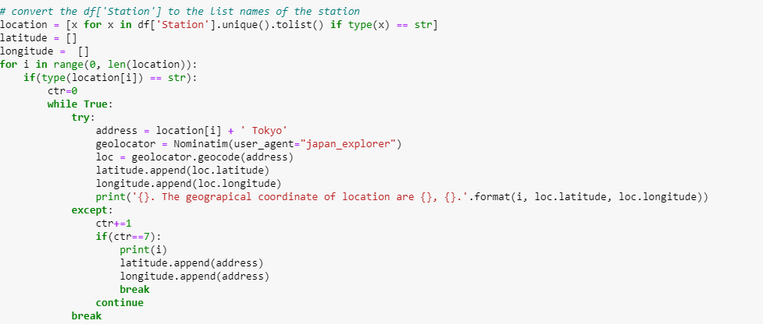
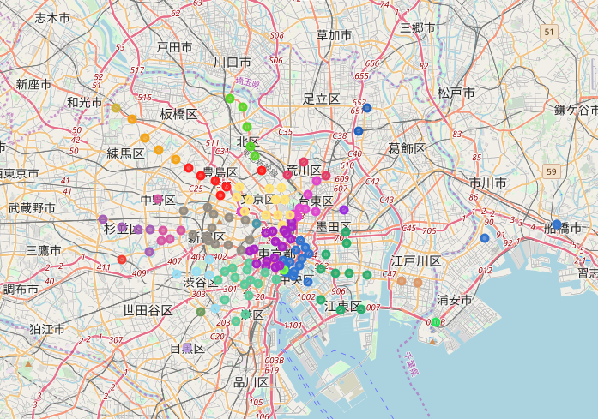
4. Implementation
Get latitude and longitude coordinates using Geocoder.
Using Nominatim and Folium to show the stations and ward in the map of Tokyo.

Slide 8
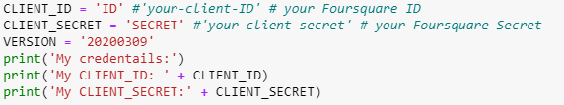

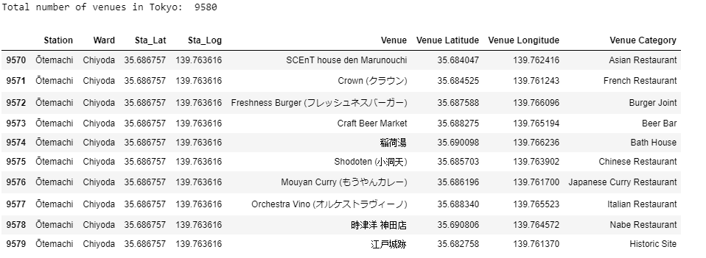
4. Implementation
Use Foursquare API to get venue data.
9580 venues from Foursquare.

Slide 9
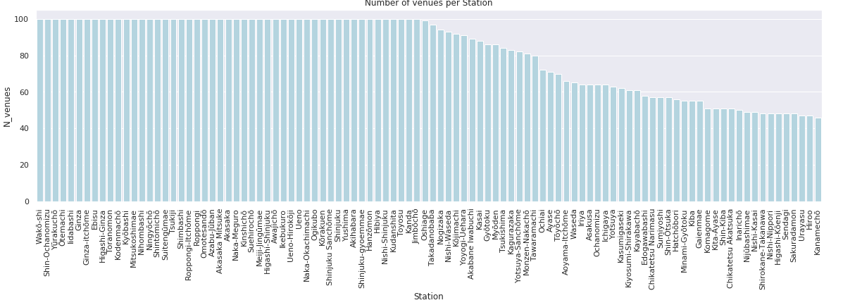
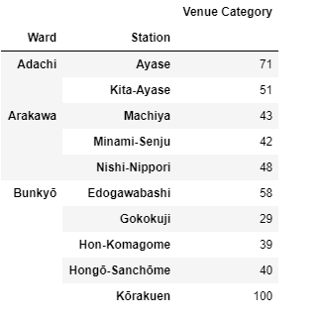
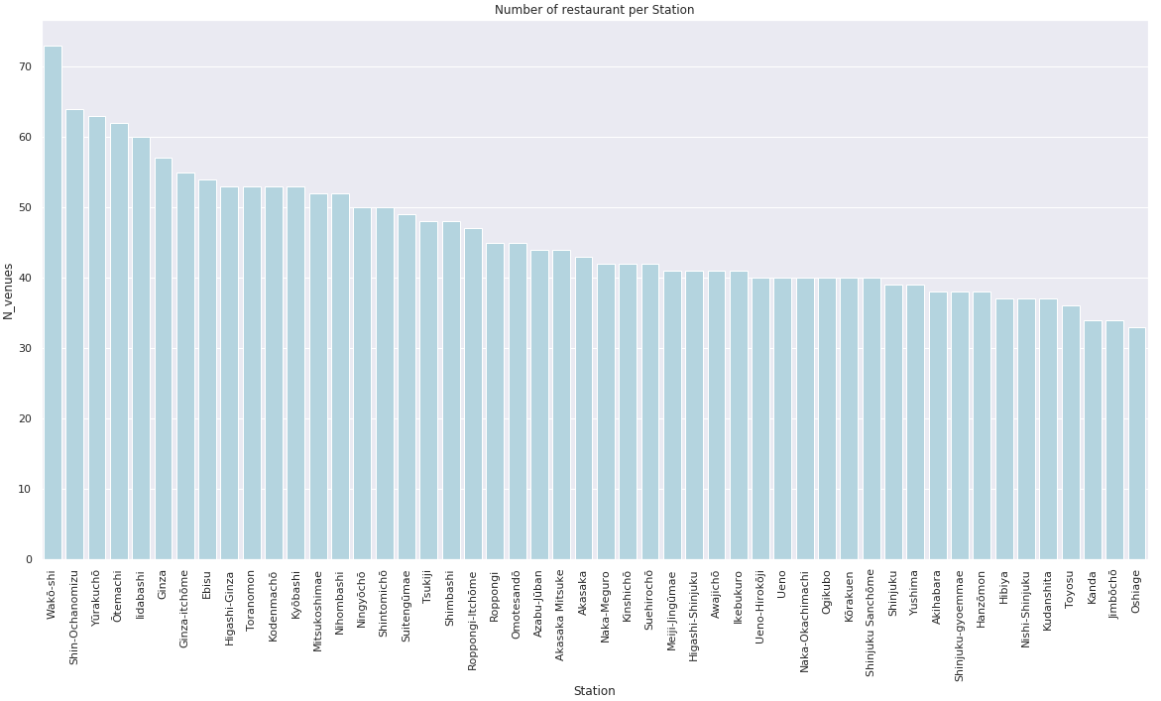
4. Implementation

Slide 10
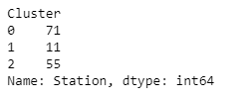

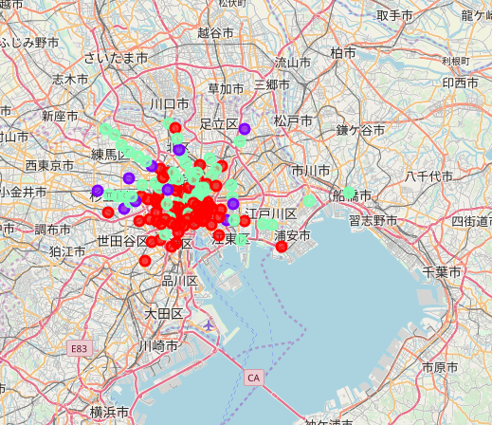
4. Implementation
Perform clustering on the data by using k-means clustering (K = 3).

Slide 11
4. Discussion
The results of the exploratory data analysis and clustering are summarized follow:
It is clear that Japanese restaurant is popular in all stations.
We can found some foreign restaurant such as Chinese restaurants, Italian restaurants, French restaurant in the stations of Cluster 1. Cluster 1 consists of main stations in the central of Tokyo.
The Cluster 2 consists of medium stations in Tokyo. Some foreign restaurant located here.
The Cluster 3 consists of small stations and outside Tokyo.

Slide 12
5. Conclusion
According to this analysis, cluster 1 station will provide most competition for an upcoming restaurant.
Some drawbacks of this analysis are the clustering is completely based on the most common venues obtained from Foursquare data.
Since land price, number of potential customers, benefits and drawbacks of station with type underground or on ground, could all play a major role and thus, this analysis is definitely far from being conclusory.

Slide 13
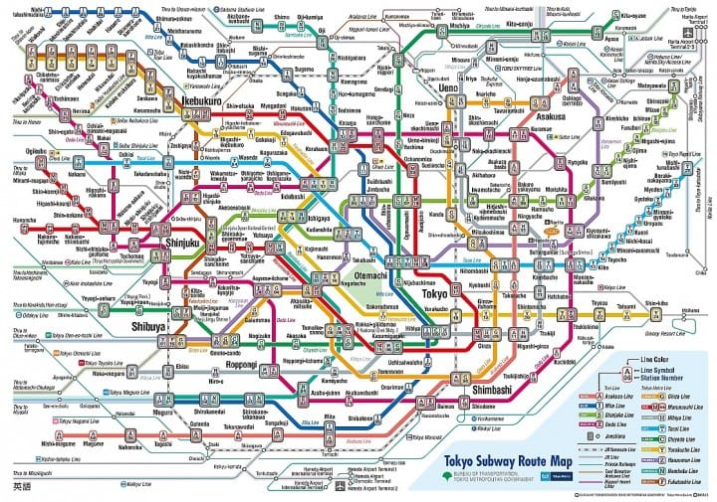
Thank you !

